Slide 1

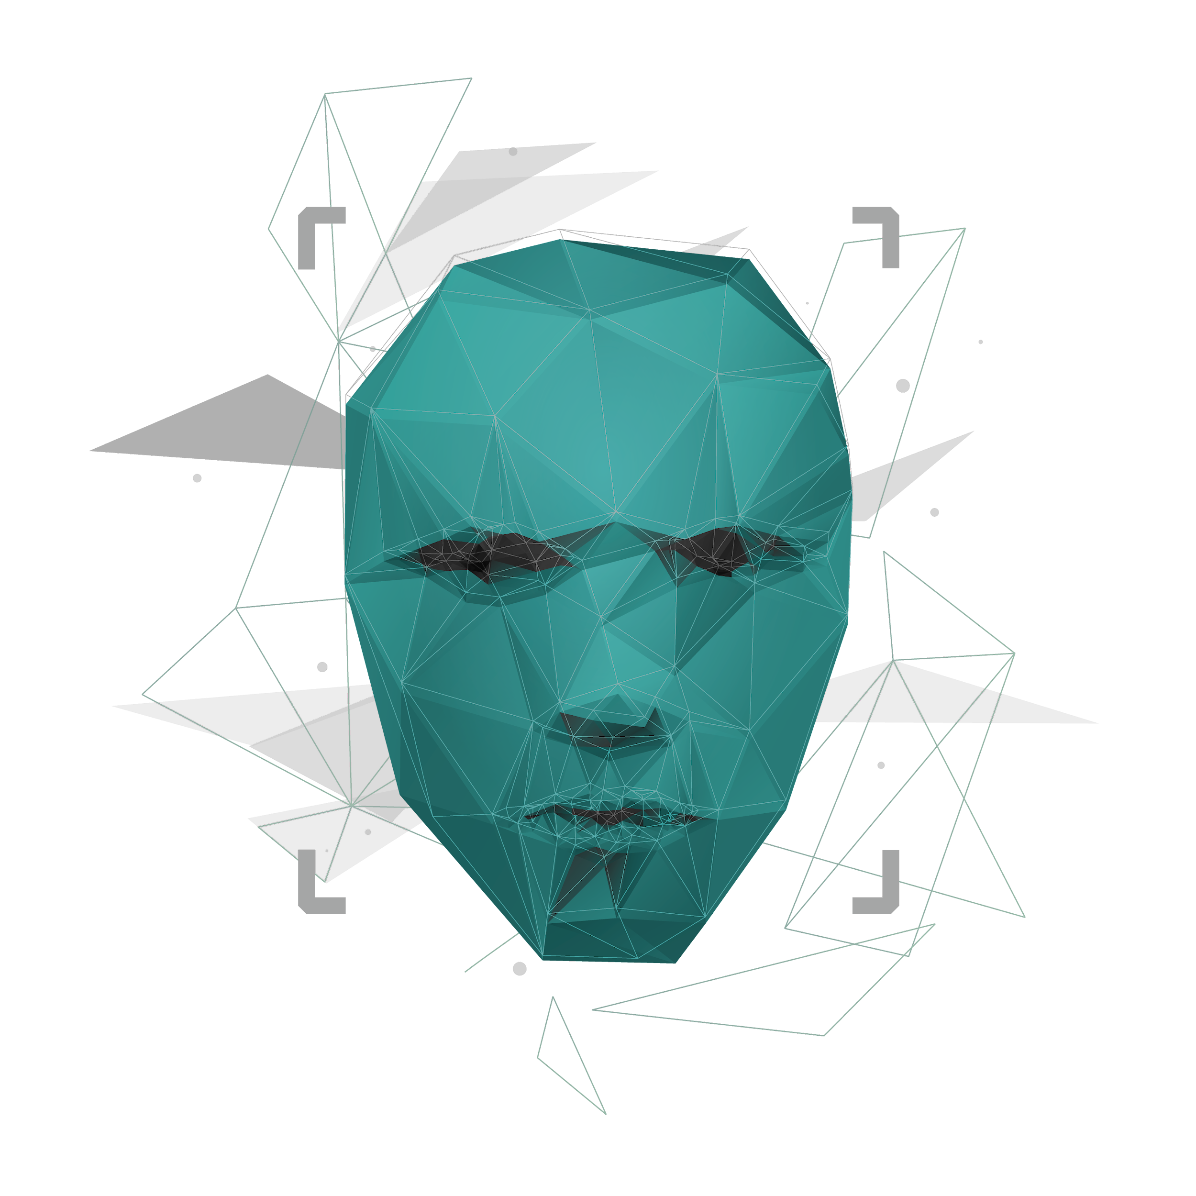
Multimodal Multimedia Integrity Verification – Detection ONOMA
Project ID : 24-25J-137

Slide 2
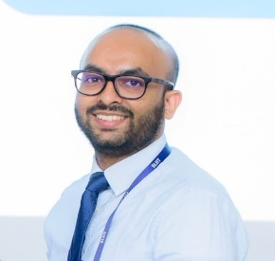
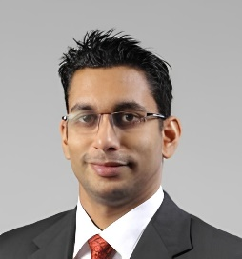

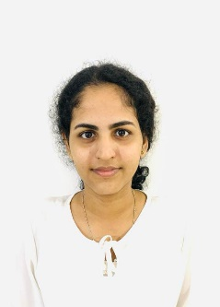
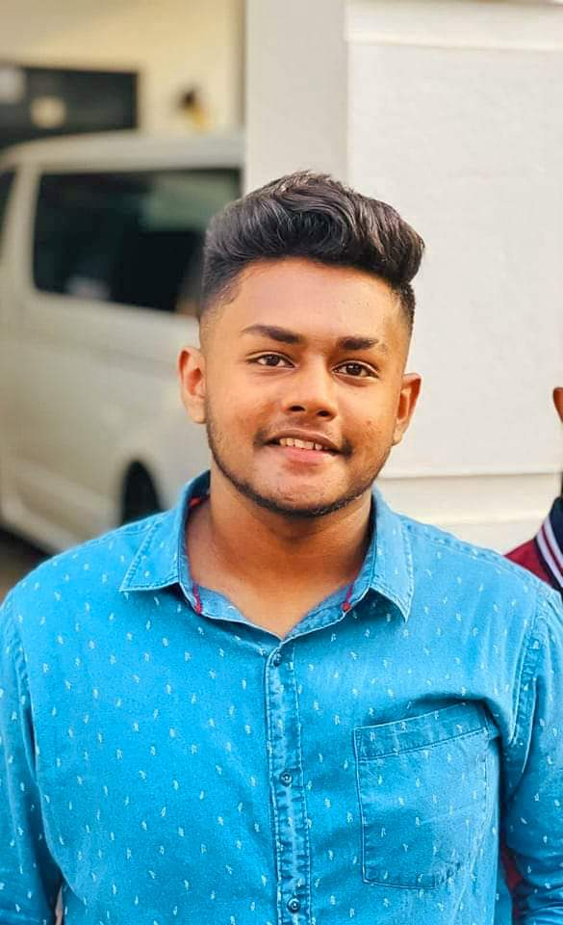
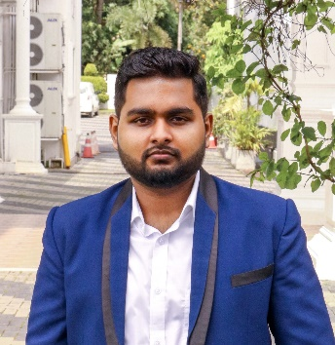
Meet The Team
MR.Kavinga Yapa ( Supervisor )
DR.Harindra Fernando ( Co-Supervisor )
ZAKEY M.S.M.A ( IT21299902 )
SHEHARA M.G.D( IT21305078 )
HASARA L.A.N ( IT21267086 )
DISSANAYAKE W.P.D.B ( IT21372308 )
(GL)
IT21299902 | ZAKEY M.S.M.A | 24-25J-137

Slide 3
Content
Introduction
01
Research Question
02
Objectives
03
Overall System diagram
04
Individual Components
05
IT21299902 | ZAKEY M.S.M.A | 24-25J-137

Slide 4
Introduction
The Multimodal Multimedia Integrity Verification system is an innovative solution designed to authenticate digital media and combat misinformation.
By employing cutting-edge machine learning and neural network technologies, the system detects deepfakes and altered content with high precision.
It ensures the credibility and security of audio, video, images and textual data, all while upholding ethical standards and protecting user privacy.
Deep Fake Audio Detection
Deep Fake Video Detection
Tampered/ Generated Image detection
Fake News Detection
IT21299902 | ZAKEY M.S.M.A | 24-25J-137

Slide 5
Research Question
How can advanced machine learning and neural network techniques be leveraged to develop a reliable and scalable system for accurately detecting deepfake media Tampered /Generated images and fake news, while minimizing false positives and ensuring ethical data handling?
IT21299902 | ZAKEY M.S.M.A | 24-25J-137

Slide 6
Objective
To develop a scalable and robust framework for detecting deepfake audio, video, tampered/generated images, and fabricated news content.
The Multimodal Multimedia Integrity Verification system leverages advanced machine learning and neural networks.
It aims to accurately identify anomalies while ensuring high accuracy and minimizing false positives, prioritizing ethical data handling to protect integrity, confidentiality, and privacy in digital communications.
IT21299902 | ZAKEY M.S.M.A | 24-25J-137

Slide 7
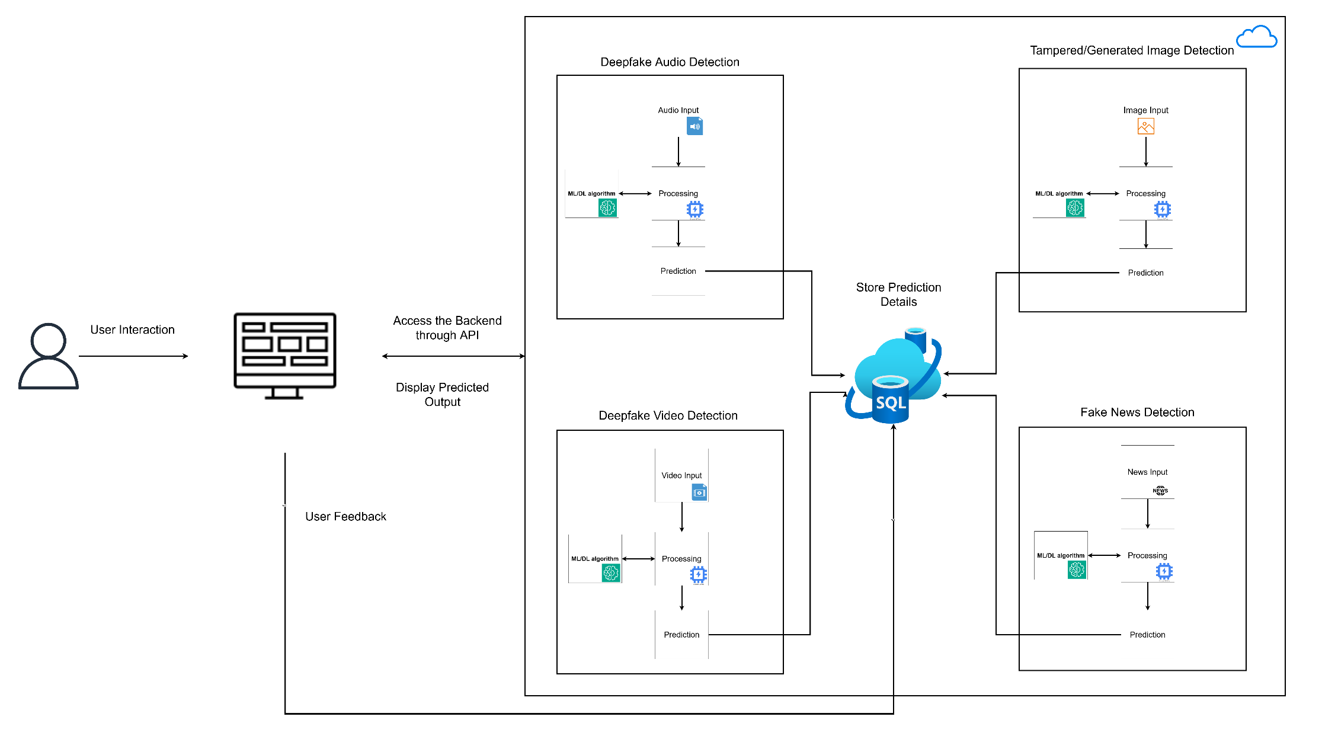
Overall System Diagram
IT21299902 | ZAKEY M.S.M.A | 24-25J-137

Slide 8
IT21299902 | ZAKEY M.S.M.A
01
Bsc in Information Technology Specialization in Cyber Security
IT21299902 | ZAKEY M.S.M.A | 24-25J-137

Slide 9
Tampered/Generated Image Detection
IT21299902 | ZAKEY M.S.M.A | 24-25J-137

Slide 10
Introduction
01
IT21299902 | ZAKEY M.S.M.A | 24-25J-137

Slide 11
Research Background
Digital media is among the many sectors whose nature was altered by the coming in of artificial intelligence and machine learning.
One of the most important technologies developed is what is called Generative Adversarial Networks , which are capable of producing images indistinguishable from the actual ones. [1]
The growth in pictures created/Altered through artificial intelligence has given rise to anxieties over
Misinformation
Identity theft
The decline of trust in any digital content.
Deepfake technology, for example, uses GANs for the creation of realistic synthetic media.
IT21299902 | ZAKEY M.S.M.A | 24-25J-137

Slide 12
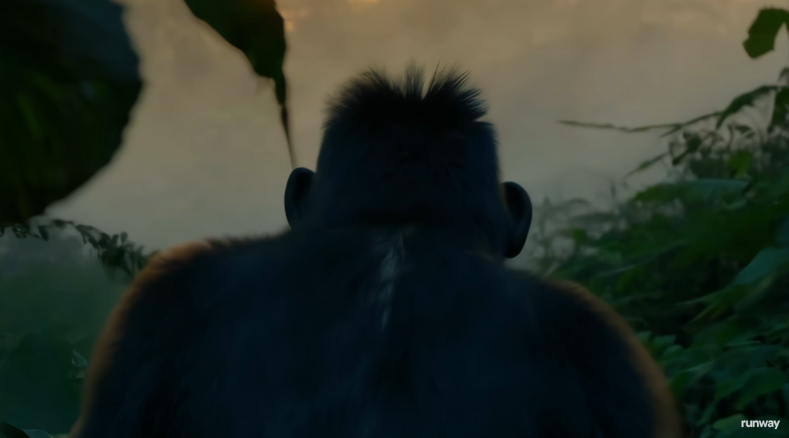
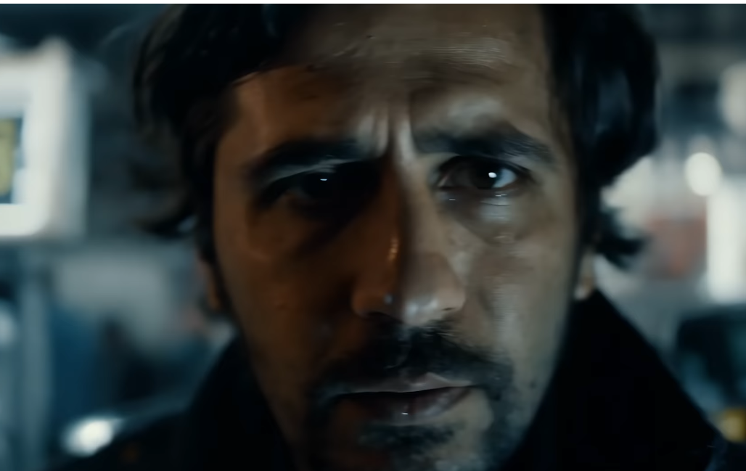
Research Background
AI Based image Generation and Alteration Frameworks
DeepDream
DALL·E
DeepFaceLab
Adobe Photoshop
Luminar AI
IT21299902 | ZAKEY M.S.M.A | 24-25J-137

Slide 13
Research Problem
The vast majority of products are based on visual examination, together with some straightforward statistical evaluations that are unable to catch extremely fine-grained artifacts, most likely caused by GANs.
Most of the detection techniques also appear to be precisely custom-made for certain picture formats, for example, JPEG.
Attackers adapt their tampering techniques to bypass detection systems, leading to reduced effectiveness over time.
Essentially, this means developing a detection system that is comprehensive, flexible, and scalable, able to identify AI-generated/Altered pictures covering a wide range of formats and increasingly growing requirement.
IT21299902 | ZAKEY M.S.M.A | 24-25J-137

Slide 14
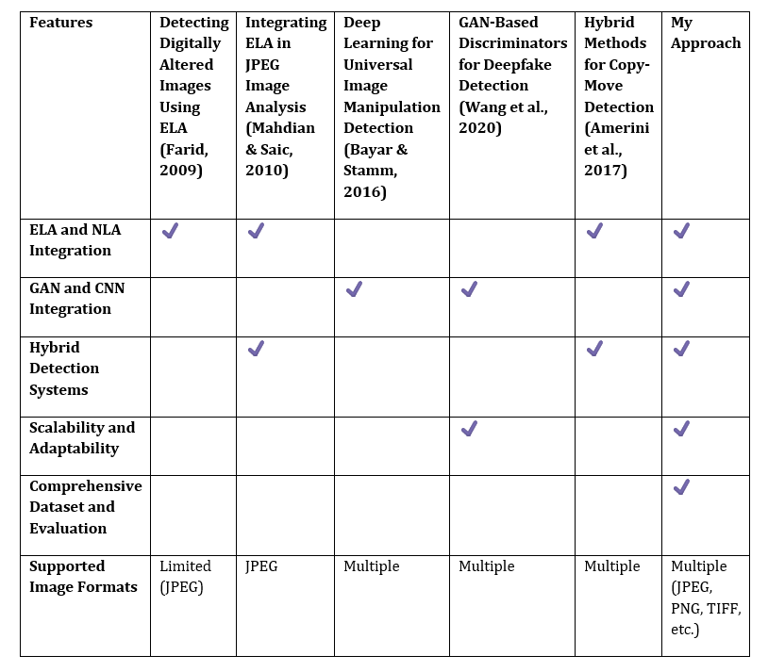
Research Gap
IT21299902 | ZAKEY M.S.M.A | 24-25J-137

Slide 15
Objectives of the Research
Main Objective
Develop an end-to-end framework for the detection of tampered and AI-generated images using traditional and modern machine learning techniques to ensure high accuracy and reliability in their identification.
Sub Objectives
Accumulate and preprocess a diverse dataset of real and AI-generated images.
Analyze and extract key features indicative of AI-generated content. metadata, noise patterns, and inconsistencies in compression.
Integrate traditional forensic methods with advanced machine learning and deep learning algorithms.
Implement a feedback loop for performance enhancement and user feedback integration.
IT21299902 | ZAKEY M.S.M.A | 24-25J-137

Slide 16
METHODOLOGY
02
IT21299902 | ZAKEY M.S.M.A | 24-25J-137

Slide 17
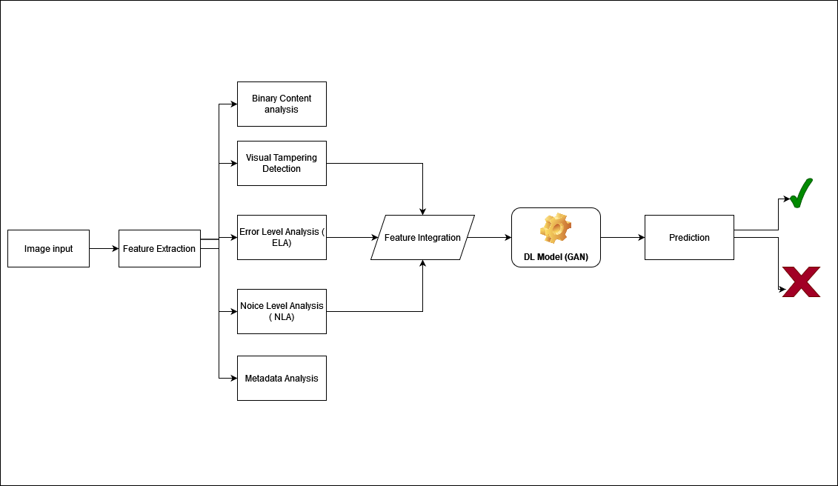
Methodology
A hybrid Architecture - Detection framework with Deep learning models like Generative adversarial network (GAN) and incorporation of ELA +NLA.
IT21299902 | ZAKEY M.S.M.A | 24-25J-137

Slide 18
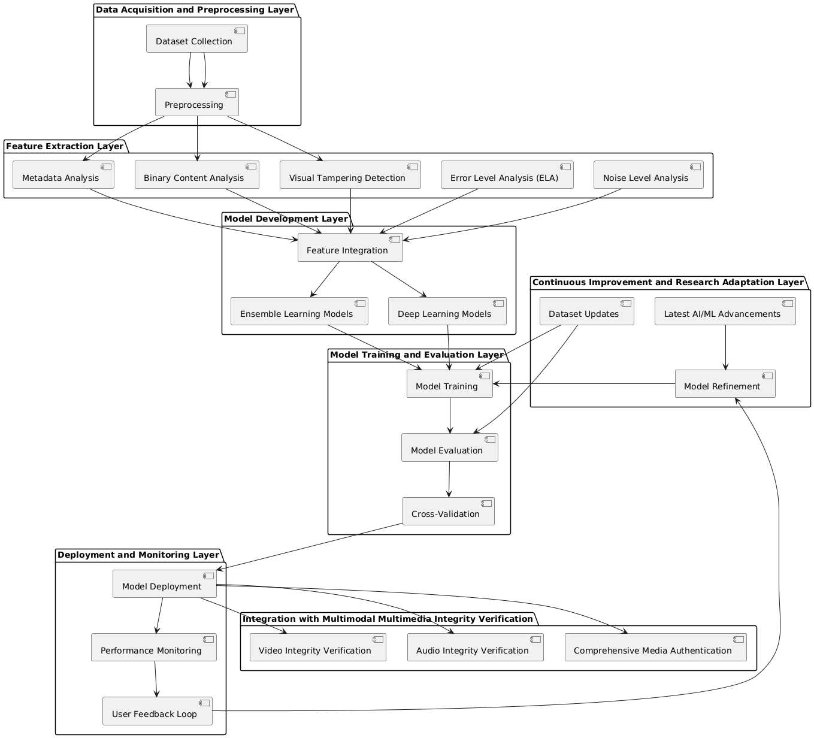
Methodology cont.
IT21299902 | ZAKEY M.S.M.A | 24-25J-137

Slide 19
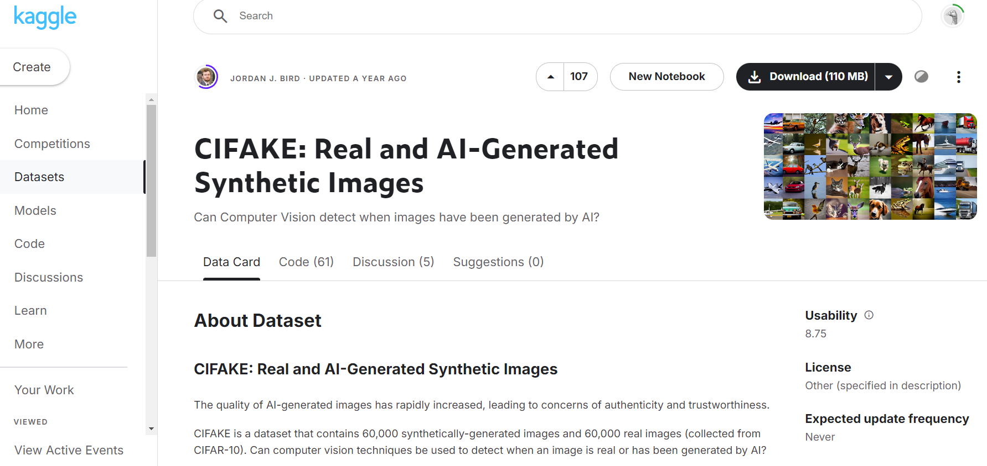
Methodology cont
Data Set
Link to Dataset - https://www.kaggle.com/datasets/birdy654/cifake-real-and-ai-generated-synthetic-images
IT21299902 | ZAKEY M.S.M.A | 24-25J-137

Slide 20







Methodology cont
Tools & Technologies
Python
Tensor flow
Google Collab
Firebase
Github
AWS
Grafana (subject to approval )
ML/DL Algorithms
IT21299902 | ZAKEY M.S.M.A | 24-25J-137

Slide 21
Methodology cont
Functional Requirements.
The system should provide a facility to upload images for analysis.
The system has to handle a lot of image formats like JPEG, PNG, BMP, and TIFF.
Provide the detailed analysis report showing the possible tampering of a given image and the AI-generated content.
Provide the user with the ability to give feedback on the results of the analysis for purposes of future improvement.
Non-Functional Requirements.
Performance
Scalability
Security ( Encryption , WAF , Access control )
Usability
IT21299902 | ZAKEY M.S.M.A | 24-25J-137

Slide 22
Methodology cont
System Requirements.
High performance server with multi core processor
Minimum 32GB RAM
GPU ( RTX or NVIDIA Tesla )
Reliable and high –bandwidth network infrastructure
IT21299902 | ZAKEY M.S.M.A | 24-25J-137

Slide 23
Work Breakdown Structure
03
IT21299902 | ZAKEY M.S.M.A | 24-25J-137

Slide 24
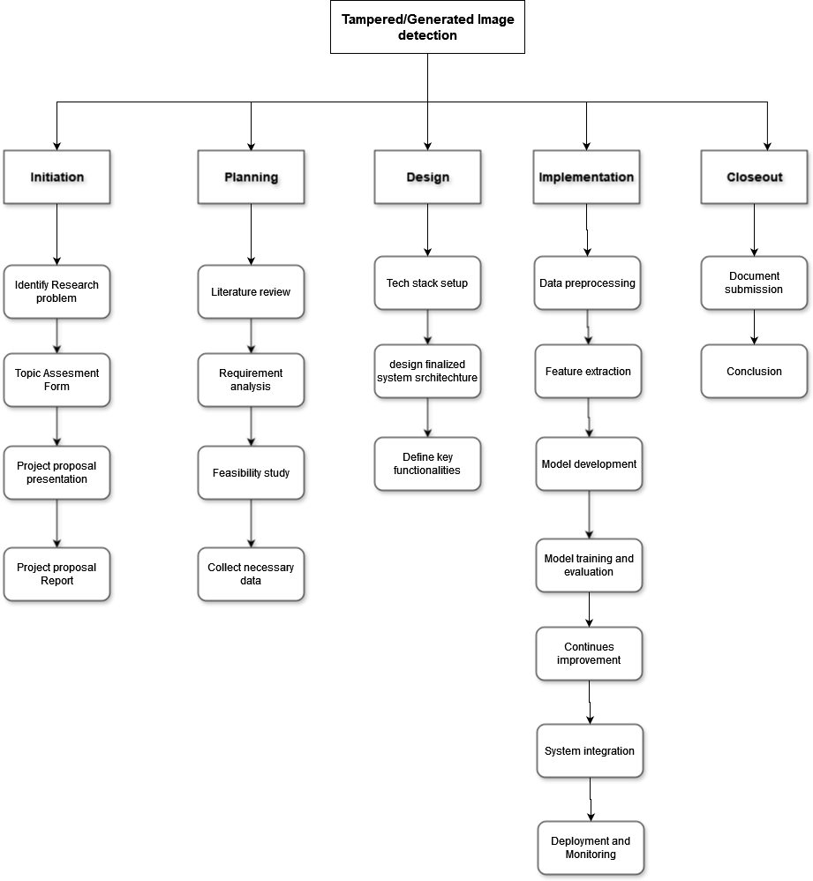
WBS cont
IT21299902 | ZAKEY M.S.M.A | 24-25J-137

Slide 25
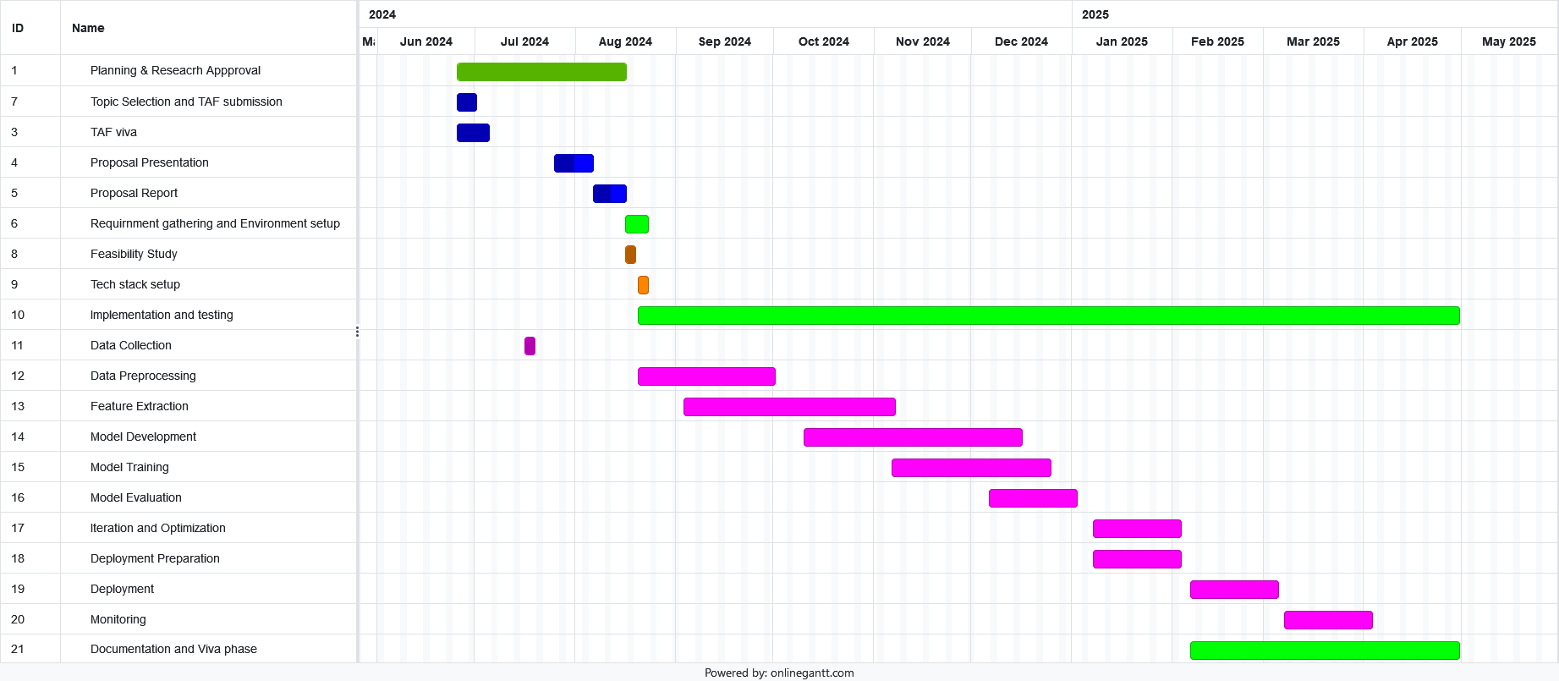
WBS cont
Grantt Chart
IT21299902 | ZAKEY M.S.M.A | 24-25J-137

Slide 26
REFERENCES
04
IT21299902 | ZAKEY M.S.M.A | 24-25J-137

Slide 27
REFERENCES cont
1. Farid, H. (2009). Techniques for detecting digitally altered images. Journal of Computational and Graphical Statistics.
2. Mahdian, B., & Saic, S. (2010). A bibliography on blind methods for identifying image forgery. Signal Processing: Image Communication.
3. Bayar, B., & Stamm, M. C. (2016). A deep learning approach to universal image manipulation detection using a new convolutional layer. Proceedings of the 4th ACM Workshop on Information Hiding and Multimedia Security.
4. Wang, S., Wang, Y., & Hwang, J. (2020). Detecting Deepfakes with GAN-based Discriminators. IEEE Transactions on Pattern Analysis and Machine Intelligence.
5. Amerini, I., Ballan, L., Caldelli, R., Del Bimbo, A., & Serra, G. (2017). A SIFT-based forensic method for copy-move attack detection and transformation recovery. IEEE Transactions on Information Forensics and Security
IT21299902 | ZAKEY M.S.M.A | 24-25J-137

Slide 28
Commercialization
IT21299902 | ZAKEY M.S.M.A | 24-25J-137

Slide 29
Commercialization cont
Market Opportunity
Growing Demand for Digital Security and Forensics.
Governments and regulatory bodies are increasingly focusing on the authenticity of digital content. This is especially relevant in legal contexts, where tampered evidence can have serious implications.
Social Media Platforms
Target Audience
Cybersecurity Firms
Law Enforcement and Legal Institutions
Media Organizations
Educational and Research Institutions
IT21299902 | ZAKEY M.S.M.A | 24-25J-137

Slide 30
Project Budget Plan
IT21299902 | ZAKEY M.S.M.A | 24-25J-137

Slide 31
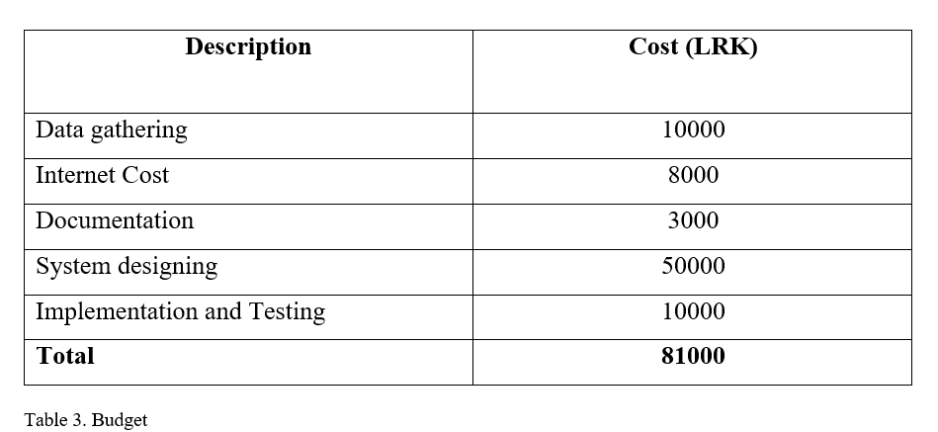
Budget Plan
IT21299902 | ZAKEY M.S.M.A | 24-25J-137

Slide 32

IT21372308 | Dissanayake w.p.d.b.
02
Bsc (Hons) in Information Technology Specialization in Cyber Security
IT21372308 | DISSANAYAKE W.P.D.B. | 24-25J-137

Slide 33
Deep Fake Video Detection
IT21372308 | DISSANAYAKE W.P.D.B. | 24-25J-137

Slide 34
Introduction
01
IT21372308 | DISSANAYAKE W.P.D.B. | 24-25J-137

Slide 35
Research Background
Utilize advanced machine learning techniques to create artificially altered but hyper-realistic videos, perfectly imitating real-life appearances and actions.
Impacts of Deep Fakes
Political Impacts
Social Impacts
Economic Impacts
Technological Impacts
IT21372308 | DISSANAYAKE W.P.D.B. | 24-25J-137

Slide 36
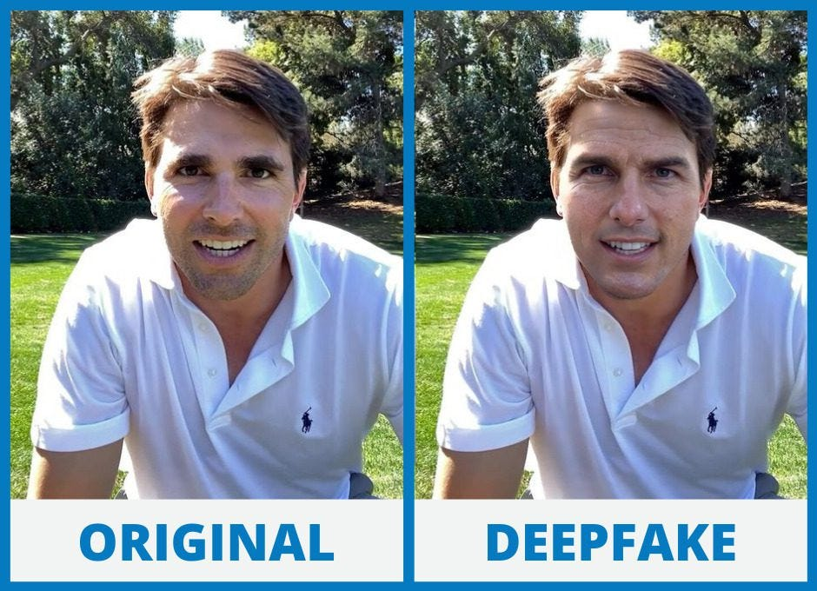
Research Background cont.
Popular deep fake video generation tools
Heygen
Deepfakes Web
DeepFaceLab
Reface
MyHeritage
Synthesia
IT21372308 | DISSANAYAKE W.P.D.B. | 24-25J-137

Slide 37
Research Problem
Current methods of detection that mainly uses CNNs and RNNs fail to capture the fine and dynamic nature of deepfake manipulations
Detection systems developed are neither robust nor adaptive to new deepfake techniques
How to develop a hybrid video detection model integrating ViTs for fine-grained spatial analysis, TCNs for time-varying temporal feature extraction, and GANs for model robustness and accuracy improvement.
IT21372308 | DISSANAYAKE W.P.D.B. | 24-25J-137

Slide 38

Research Gap
Features | Detection of Deepfake Videos Using CNNs and RNNs (Paper 1) | Challenges and Opportunities in Deepfake Detection (Paper 2) | Deepfake Strategies and Challenges (Paper 3) | Survey of Deepfake Generation and Detection (Paper 4) | Deepfake Detection Using Neural Networks (Paper 5) | My Approach
Integration of Spatial and Temporal Analysis
Use of GANs for Training Data
Scalability and Adaptability
Supported Video Formats
Evaluation on Diverse Datasets
IT21372308 | DISSANAYAKE W.P.D.B. | 24-25J-137

Slide 39
Objectives of the Research
Main Objective
Design and train a deepfake video detection framework integrating ViTs, TCNs, and GANs that could effectively capture both spatial instabilities and temporal anomalies in video sequences.
Sub Objectives
Measure the performance of ViT to detect spatial anomalies in a single frame of a deepfake video.
Study the potential of TCNs in detecting temporal inconsistencies in videos in comparison with RNNs and LSTMs.
Integrate GANs within the detection framework.
Testing the hybrid model over different datasets and implement a feedback loop.
IT21372308 | DISSANAYAKE W.P.D.B. | 24-25J-137

Slide 40
METHODOLOGY
02
IT21372308 | DISSANAYAKE W.P.D.B. | 24-25J-137

Slide 41
Methodology
A hybrid method – Video Detection framework which utilizes ViTs for spatial analysis and TCN for extracting temporal features with GANs for improving model robustness and accuracy
IT21372308 | DISSANAYAKE W.P.D.B. | 24-25J-137

Slide 42
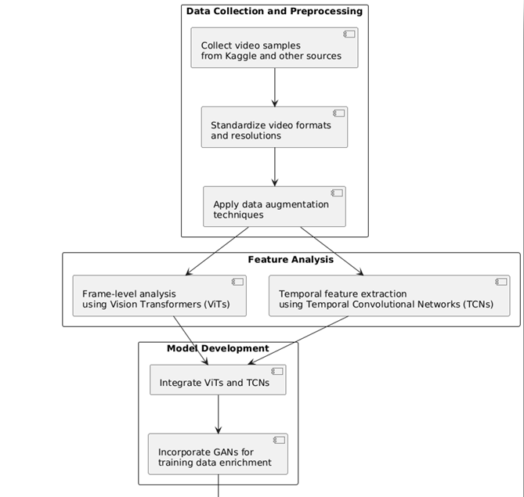
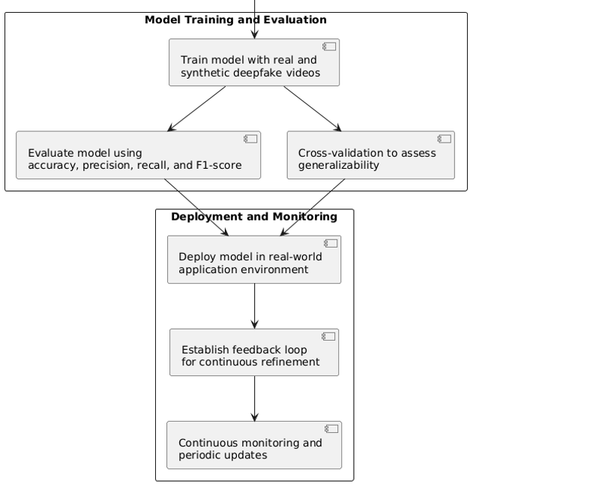
Methodology cont.
IT21372308 | DISSANAYAKE W.P.D.B. | 24-25J-137

Slide 43
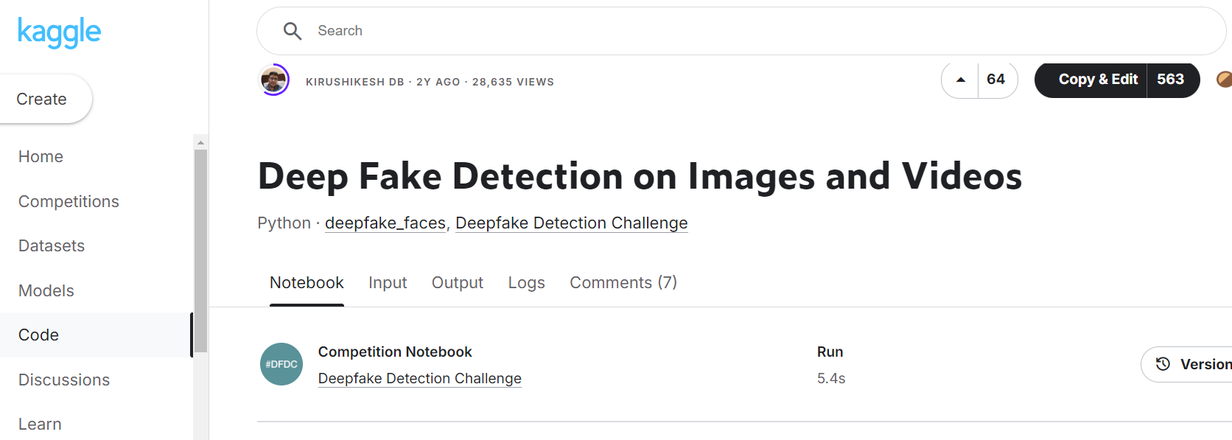
Methodology cont.
Data Set
Link to Dataset - https://www.kaggle.com/code/krooz0/deep-fake-detection-on-images-and-videos
IT21372308 | DISSANAYAKE W.P.D.B. | 24-25J-137

Slide 44



Methodology cont.
Technologies & Tools
Kaggle (for dataset)
TensorFlow
PyTorch
Google collab
Github
Docker
ML/DL Algorithms
Data Augmentation Techniques
IT21372308 | DISSANAYAKE W.P.D.B. | 24-25J-137

Slide 45
Methodology cont.
Functional Requirements
The user should be able to upload videos for analysis.
The system has to handle multiple video formats like MP4, AVI, MKV, WebM
Provide the user with the ability to give feedback on the results of the analysis for purposes of future improvement.
Non-Functional Requirements
Performance
Scalability
Accuracy
Security
IT21372308 | DISSANAYAKE W.P.D.B. | 24-25J-137

Slide 46
Methodology cont.
System Requirements
High-performance CPU (e.g., Intel Core i5 or AMD Ryzen 5)
Minimum 32GB RAM
High Performance GPU ( Nvidia or AMD )
256 TB SSD storage for fast read/write operations
Reliable and high –bandwidth network infrastructure
IT21372308 | DISSANAYAKE W.P.D.B. | 24-25J-137

Slide 47
Work Breakdown Structure
03
IT21299902 | ZAKEY M.S.M.A | 24-25J-137

Slide 48
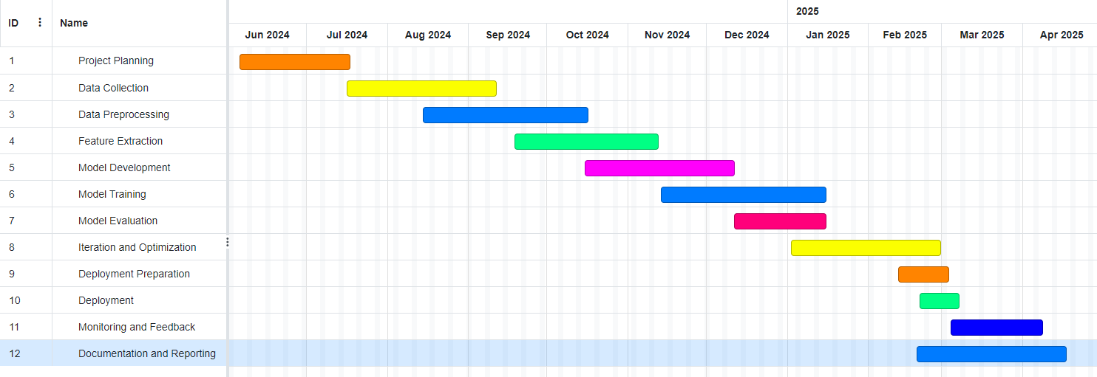
WBS
Gantt Chart
IT21372308 | DISSANAYAKE W.P.D.B. | 24-25J-137

Slide 49
Commercialization
04
IT21299902 | ZAKEY M.S.M.A | 24-25J-137

Slide 50
Commercialization
Market Opportunity
Rising Incidents of Deepfake Threats
Regulatory and Compliance Requirements
Adoption in Cybersecurity
Growth in Digital Media and Content Verification
Market Size and Potential
IT21372308 | DISSANAYAKE W.P.D.B. | 24-25J-137

Slide 51
Commercialization cont.
Target Audience
Law Enforcement and Government Agencies
Media and Entertainment Industry
Corporate Sector
Cybersecurity Firms
Academic and Research Institutions
IT21372308 | DISSANAYAKE W.P.D.B. | 24-25J-137

Slide 52
Project Budget Plan
05
IT21299902 | ZAKEY M.S.M.A | 24-25J-137

Slide 53
Project Budget Plan
Description | Cost(LKR)
Data gathering | 10000
Internet Cost | 2000
Documentation | 6000
System designing | 45000
Implementation & Testing | 10000
Total | 73000
IT21372308 | DISSANAYAKE W.P.D.B. | 24-25J-137

Slide 54
REFERENCES
1. A. S. George and A. . George, “Deepfakes: The Evolution of Hyper realistic Media Manipulation,” vol. 01, pp. 58–74, Dec. 2023, doi: 10.5281/zenodo.10148558.
2. F. Abbas and A. ?aeihagh, “Unmasking deepfakes: A systematic review of deepfake detection and generation techniques using artificial intelligence,” Expert Syst. Appl., vol. 252, p. 124260, May 2024, doi: 10.1016/j.eswa.2024.124260.
3. Z. Xia, T. Qiao, M. Xu, N. Zheng, and S. Xie, “Towards DeepFake video forensics based on facial textural disparities in multi-color channels,” Inf. Sci. (Ny)., vol. 607, pp. 654–669, 2022, doi: https://doi.org/10.1016/j.ins.2022.06.003.
4. S. Al-khazraji, H. Saleh, A. KHALID, and I. Mishkhal, “Impact of Deepfake Technology on Social Media: Detection, Misinformation and Societal Implications,” Eurasia Proc. Sci. Technol. Eng. Math., vol. 23, pp. 429–441, Oct. 2023, doi: 10.55549/epstem.1371792.
5. S. Agarwal, H. Farid, T. El-Gaaly, and S.-N. Lim, Detecting Deep-Fake Videos from Appearance and Behavior. 2020.
IT21372308 | DISSANAYAKE W.P.D.B. | 24-25J-137

Slide 55

IT21305078 | Shehara M. G. D
BSc (Hons) in Information Technology Specialising in Cybersecurity
IT21305078 | Shehara M. G. D| 24-25j-137

Slide 56
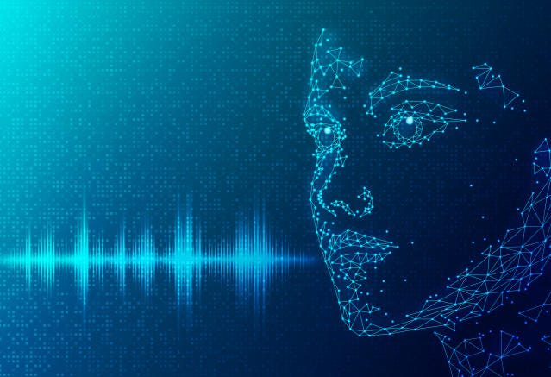
Deepfake Audio Detection
IT21305078 | Shehara M. G. D| 24-25j-137

Slide 57
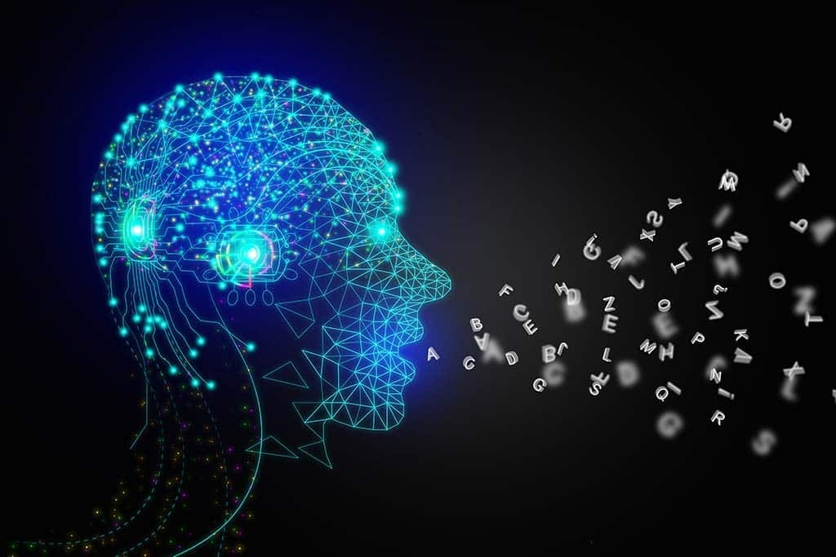
Background
Rapid development in deep learning and deepfake technologies.
Positive applications as well as severe risks of deepfake audio.
Need for improved detection methods integrating psychoacoustic analysis and bioinspired algorithms for multilingual audio.
IT21305078 | Shehara M. G. D| 24-25j-137

Slide 58
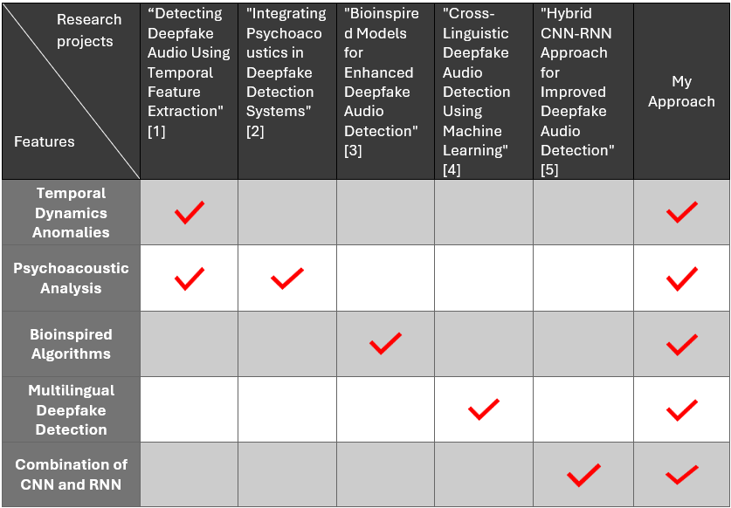
Research Gap
IT21305078 | Shehara M. G. D| 24-25j-137

Slide 59

Research Problem
Existing deepfake audio detection systems struggle to accurately identify synthetic audio that closely mimics human speech.
Limitations of current detection systems.
Importance of psychoacoustic principles and multilingual applicability.
IT21305078 | Shehara M. G. D| 24-25j-137

Slide 60
Research Questions
How can psychoacoustic analysis enhance deepfake audio detection by identifying perceptually relevant anomalies?
What key features distinguish genuine from deepfake audio in Chinese and English?
How bioinspired algorithms improve detection accuracy and resilience compared to conventional methods?
What strategies can address challenges in developing a multilingual detection system?
IT21305078 | Shehara M. G. D| 24-25j-137

Slide 61
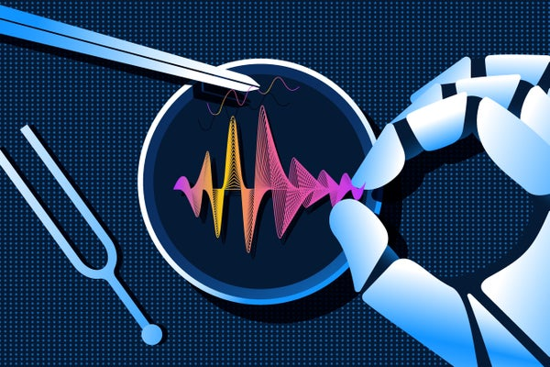
Main Objective
To efficiently identify multilingual synthetic audio using both technical discrepancies and perceptual cues derived from psychoacoustic parameters and bio-inspired algorithms.
IT21305078 | Shehara M. G. D| 24-25j-137

Slide 62
Sub Objectives
Compile a diverse audio dataset (Chinese, English)
Extract psychoacoustic features (Intonation, Rhythm)
Construct a machine learning model (CNNs, RNNs)
Evaluate using accuracy, precision, recall, F1-score
Continuous model improvement and updates
IT21305078 | Shehara M. G. D| 24-25j-137

Slide 63
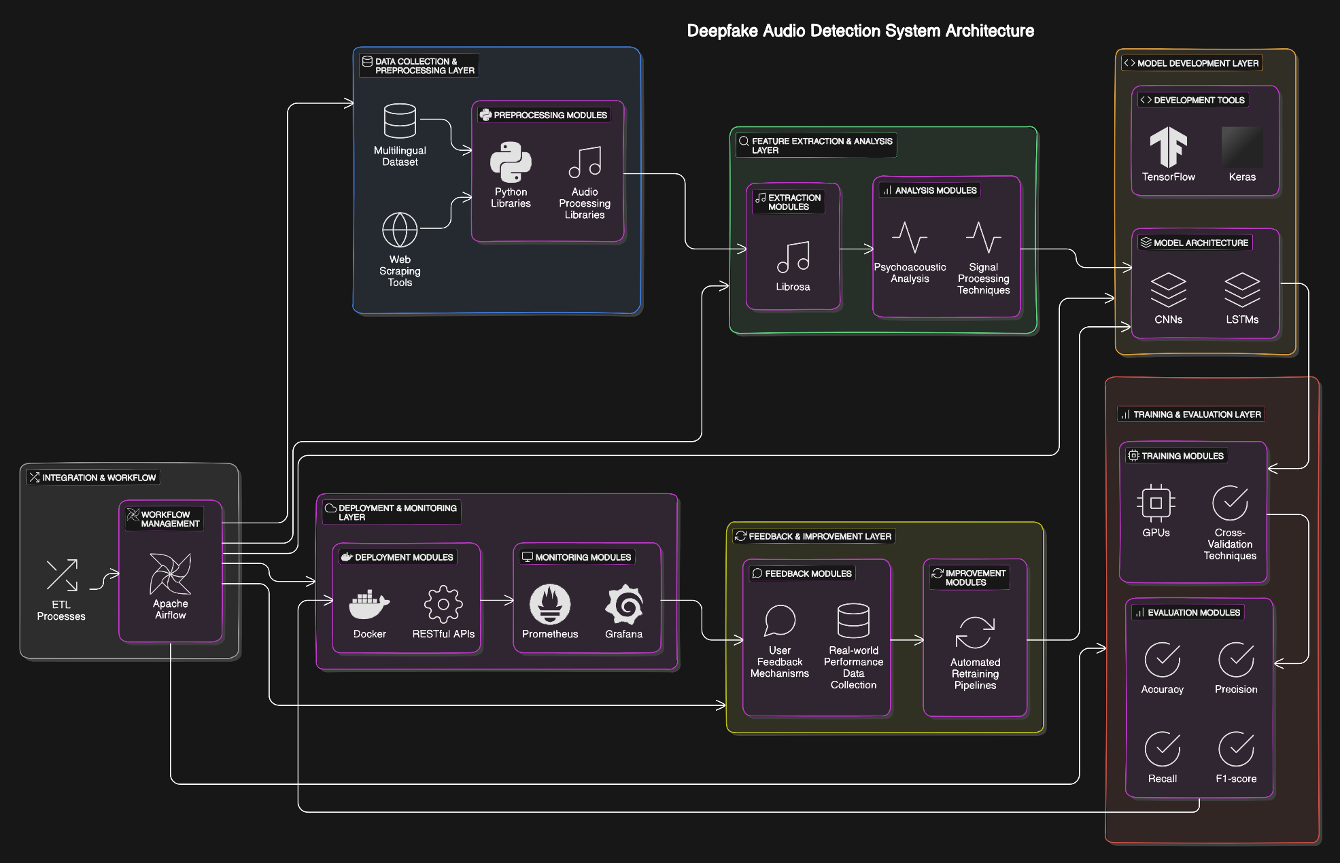
System Diagram
IT21305078 | Shehara M. G. D| 24-25j-137

Slide 64
Technologies and Tools to Be Used
Python: The primary programming language for developing and implementing machine learning models.
TensorFlow and Keras: Deep learning frameworks for building and training neural networks.
Scikit-learn: For implementing machine learning algorithms and data preprocessing.
Docker and Kubernetes: For containerization and orchestration of the application, ensuring scalability and easy deployment.
.
IT21305078 | Shehara M. G. D| 24-25j-137

Slide 65
Technologies and Tools to Be Used
Tools:
Git and GitHub: For version control and collaborative development.
Visual Studio Code and PyCharm: Integrated development environments (IDEs) for coding.
MATLAB: For advanced signal processing and analysis.
Audacity and Praat: For audio analysis and feature extraction.
AWS, Google Cloud Platform, and Microsoft Azure: Cloud services for scalable computing resources.
IT21305078 | Shehara M. G. D| 24-25j-137

Slide 66
System Requirement Specification (SRS)
Hardware Requirements:
High-performance CPU (e.g., Intel Core i5 or AMD Ryzen 5)
Minimum 32 GB RAM
GPU with CUDA support (e.g., NVIDIA RTX 3080)
256 TB SSD storage for fast read/write operations
High-quality audio input devices
Network Requirements:
High-speed internet connection
Secure VPN access for remote data handling
IT21305078 | Shehara M. G. D| 24-25j-137

Slide 67
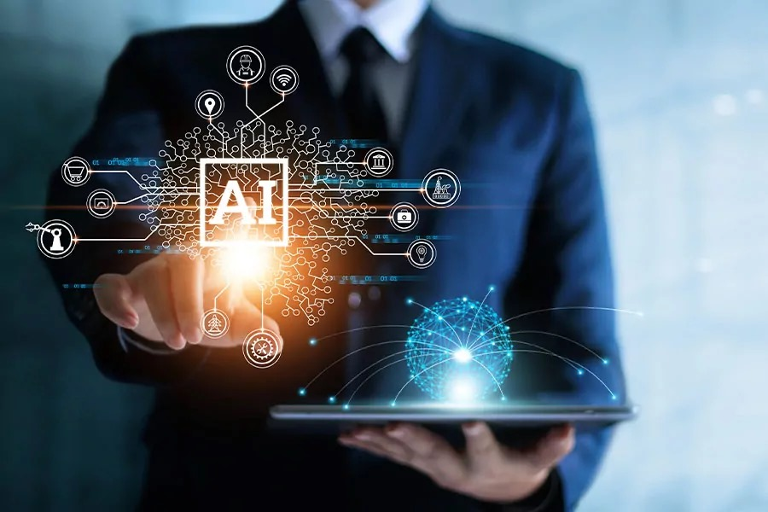
System Requirement Specification (SRS)
3. Operating System:
Linux (Ubuntu 20.04 or later) or Windows 10/11
Compatibility with other UNIX-based systems for deployment
4. Non - Functional Requirements
Performance
Scalability
Security
Reliability
Usability
Compliance
IT21305078 | Shehara M. G. D| 24-25j-137

Slide 68
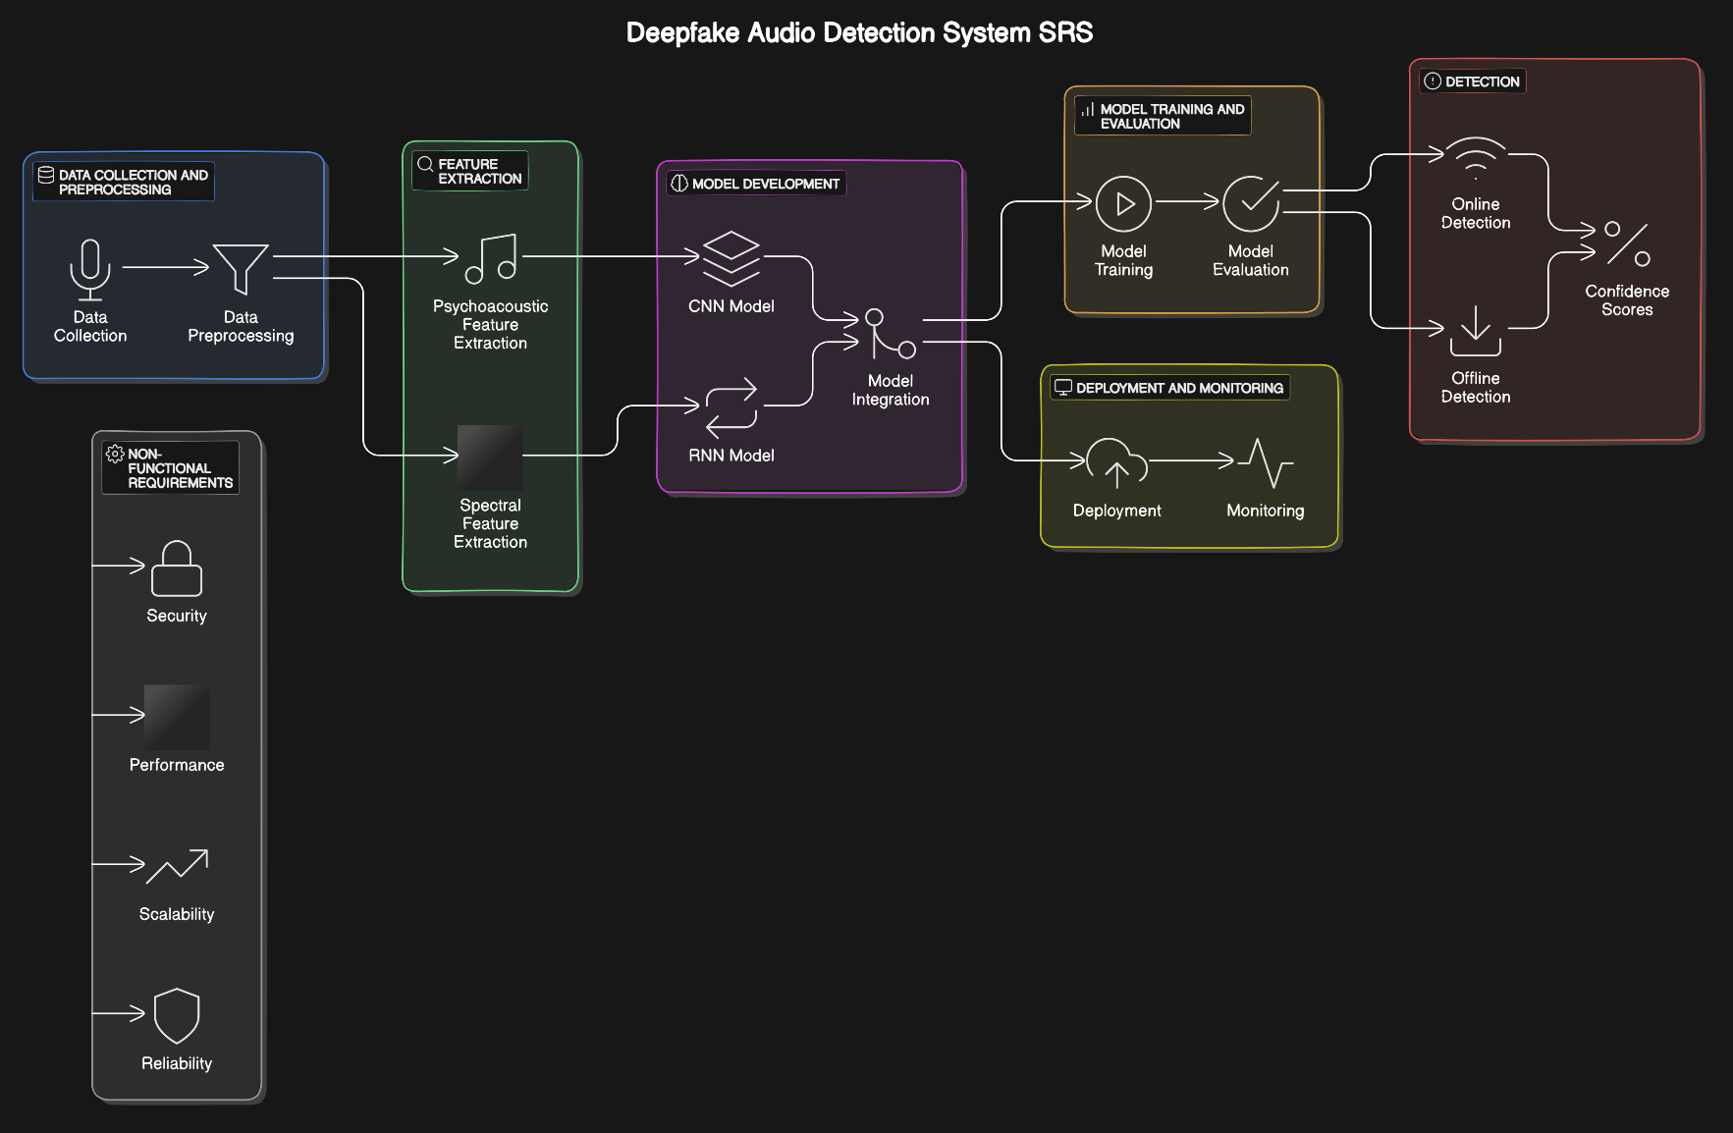
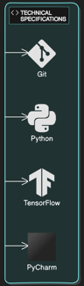
SRS Diagram
IT21305078 | Shehara M. G. D| 24-25j-137

Slide 69
Software Requirement Specification
Programming Languages:
Python for machine learning and data analysis
Software Frameworks and Libraries:
TensorFlow/Keras and PyTorch for neural network implementation
Librosa for audio signal analysis
OpenCV for additional computer vision tasks
SciKit-learn for traditional machine learning models
IT21305078 | Shehara M. G. D| 24-25j-137

Slide 70
Software Requirement Specification
Database and Data Storage:
MongoDB or PostgreSQL for metadata storage
Version Control:
Git for source code management
Testing and Deployment:
Docker for containerization and deployment
IT21305078 | Shehara M. G. D| 24-25j-137

Slide 71
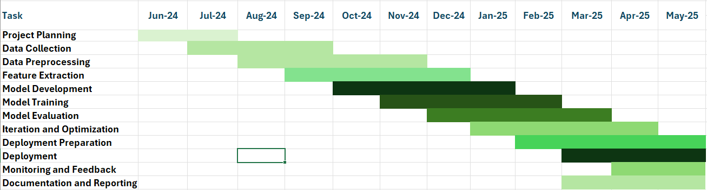
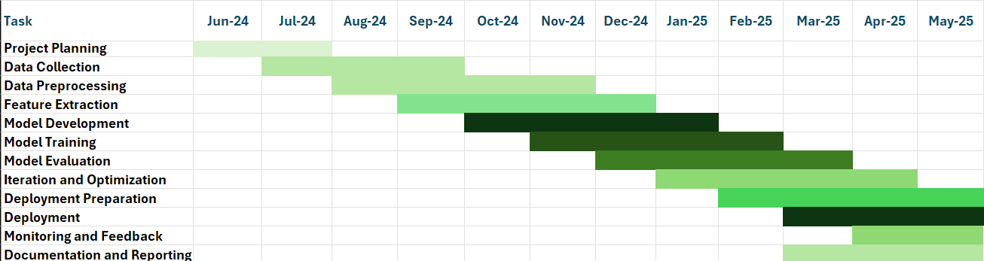
Gannt Chart
IT21305078 | Shehara M. G. D| 24-25j-137

Slide 72
Commercialization
Market Opportunity
Growing concern over misinformation and digital media integrity
Increasing demand from industries such as media, law enforcement, and cybersecurity
Target Audience
Legal and forensic experts
News organizations
Social media platforms.
Corporate security teams
IT21305078 | Shehara M. G. D| 24-25j-137

Slide 73
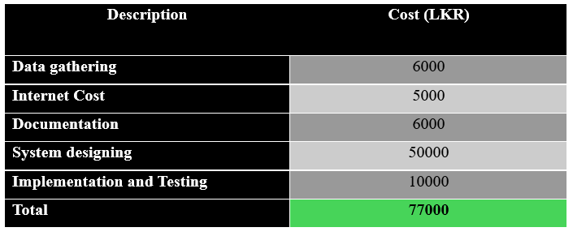
Budget
IT21305078 | Shehara M. G. D| 24-25j-137

Slide 74
References
[1] A. Qais, A. Rastogi, A. Saxena, A. Rana and D. Sinha, "Detecting Deepfake Audio Using Temporal Feature Extraction," 2022 International Conference on Intelligent Controller and Computing for Smart Power (ICICCSP), Hyderabad, India, 2022, pp. 1-6, doi: 10.1109/ICICCSP53532.2022.9862519. keywords: {Deepfakes;Recurrent neural networks;Feature extraction;Data models;Numerical models;Convolutional neural networks;Arrays;Convolutional neural network;Audio Processing;FFT;Fast Fourier Transform;MFCC: Mel Frequency Cepstral Coefficient;STFT: Short Time Fourier Transform;Spectrogram;Spoofing detection},
[2] L. Nguyen-Vu, T. -P. Doan, M. Bui, K. Hong and S. Jung, "Integrating Psychoacoustics in Deepfake Detection Systems," in IEEE Access, vol. 11, pp. 94563-94574, 2023, doi: 10.1109/ACCESS.2023.3310809.keywords: {Band-pass filters;Training;Psychoacoustic models;Perturbation methods;Robustness;Closed box;Spectrogram;Adversarial machine learning;Psychoacoustic models;Automatic speaker verification;adversarial attack;spoofing countermeasure;psychoacoustics},
[3] T. Cazalets and J. Dambre, "Bioinspired Models for Enhanced Deepfake Audio Detection," 2023 RIVF International Conference on Computing and Communication Technologies (RIVF), Hanoi, Vietnam, 2023, pp. 458-463, doi: 10.1109/RIVF60135.2023.10471845. keywords: {Heuristic algorithms;Biological system modeling;Time series analysis;Speech recognition;Computer architecture;Homeostasis;Reservoirs},
[4] Z. Khanjani, L. Davis, A. Tuz, K. Nwosu, C. Mallinson and V. P. Janeja, "Cross-Linguistic Deepfake Audio Detection Using Machine Learning," 2023 IEEE International Conference on Intelligence and Security Informatics (ISI), Charlotte, NC, USA, 2023, pp. 01-06, doi: 10.1109/ISI58743.2023.10297267. keywords: {Training;Annotations;Linguistics;Phonetics;Media;Feature extraction;Security;audio deepfake;spoofed audio detection;Artificial Intelligence;linguistics;sociolinguistics;linguistic perception},
[5] Al-Adwan, A.; Alazzam, H.; Al-Anbaki, N.; Alduweib, E. Hybrid CNN-RNN Approach for Improved Deepfake Audio Detection. Computers 2024, 13, 99. https://doi.org/10.3390/computers13040099
IT21305078 | Shehara M. G. D| 24-25j-137

Slide 75

IT21267086 | Hasara L. A. N
BSc (Hons) in Information Technology Specialising in Cyber Security
IT21267086 | Hasara L. A. N | 24-25j-137

Slide 76
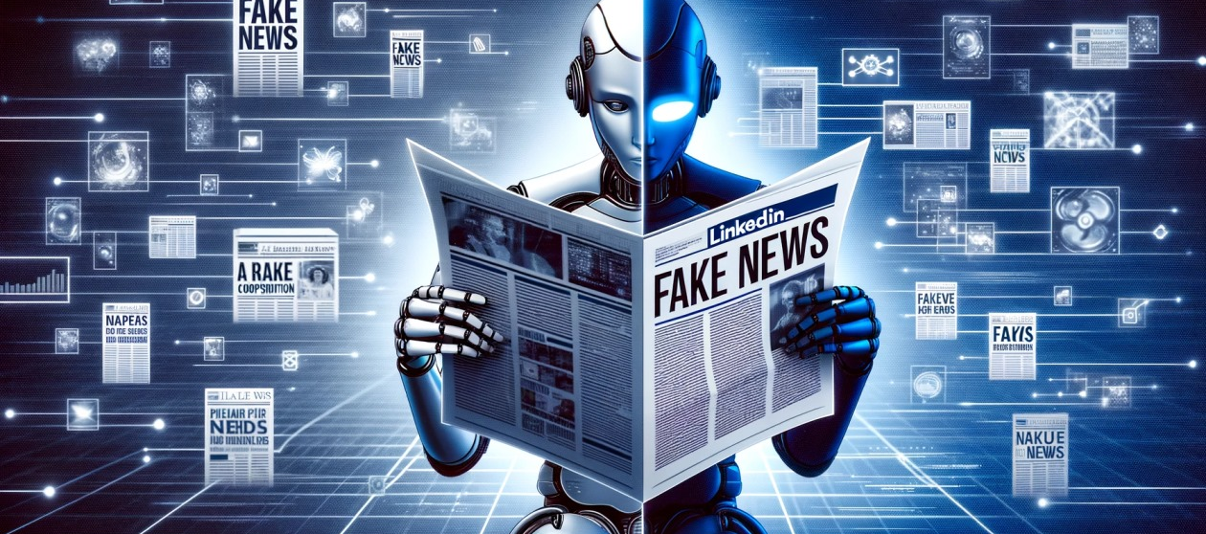
Fake News Detection

Slide 77
Research Background
The rise of fake news in the digital age harms the credibility of information distribution.
Fake news affects politics, health, and finance due to the widespread use of social media.
Traditional fact-checking is labor-intensive and can't keep up with fast-paced online misinformation.
Advanced NLP with multi-textual analysis offers a robust approach to fake news detection.
Deep learning for accurate detection using multi-textual analysis.
IT21267086 | Hasara L. A. N | 24-25j-137

Slide 78
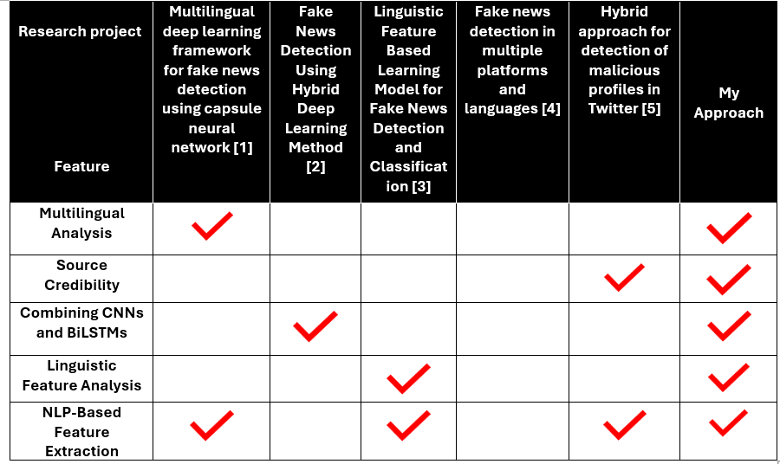
Research Gap
IT21267086 | Hasara L. A. N | 24-25j-137

Slide 79

Research Problem
Existing detection systems are primarily designed for English content.
Current systems struggle to adapt to evolving fake news tactics.
Need for a dynamic, ever-learning approach to handle global misinformation.
Existing methods often fail to address local and sequential patterns critical for accurate detection.
Incorporating source credibility assessments can improve overall
detection effectiveness.
IT21267086 | Hasara L. A. N | 24-25j-137

Slide 80
Research Questions
1. How can advanced NLP techniques be effectively integrated to assess both content and context in fake news detection?
2. What strategies can be employed to improve fake news detection across multiple languages?
3. How can a dynamic, ever-learning approach be developed to adapt to evolving fake news tactics?
4. What methods can be used to identify and capture local and sequential patterns critical for accurate fake news detection?
IT21267086 | Hasara L. A. N | 24-25j-137

Slide 81
Main Objective
To develop, construct, and evaluate a fully functional system for fake news detection that utilize both textual multi-language content and contextual analysis to enhance the reliability and resilience of the system in accurately identifying fake news.
IT21267086 | Hasara L. A. N | 24-25j-137

Slide 82
Sub Objectives
Compile a multilingual dataset from various news sources, ensuring comprehensive coverage of actual and fake news material.
Utilize modern NLP techniques to perform deep textual analysis, extracting meaningful features from the dataset.
Develop and integrate a deep learning models that incorporates textual analysis.
Conduct thorough testing to assess model efficacy, incorporating mechanisms for continuous learning.
Ensure the model adapts to emerging patterns of fake news, maintaining long-term reliability and scalability.
IT21267086 | Hasara L. A. N | 24-25j-137

Slide 83
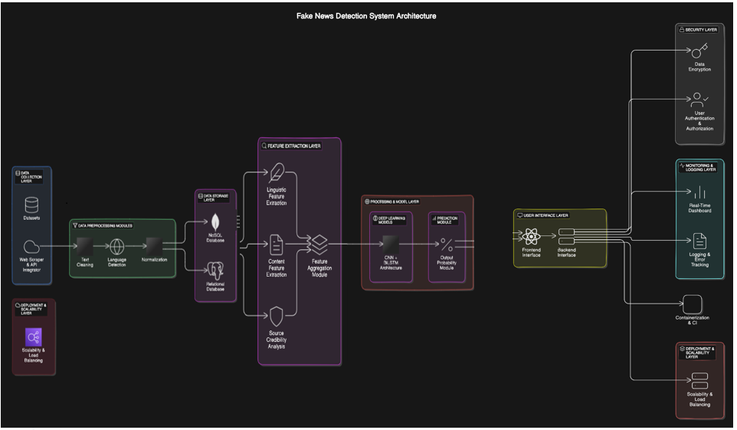
System Diagram
IT21267086 | Hasara L. A. N | 24-25j-137

Slide 84
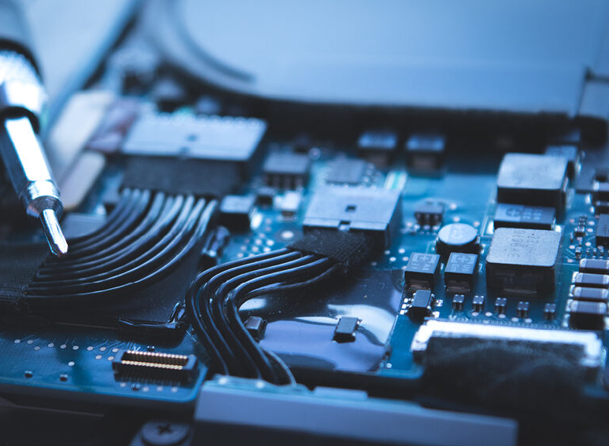
Hardware Requirements
CPU: Multi-core processor (e.g., Intel i7 or equivalent).
RAM: Minimum of 16GB.
Storage: SSD with at least 1TB capacity.
IT21267086 | Hasara L. A. N | 24-25j-137

Slide 85
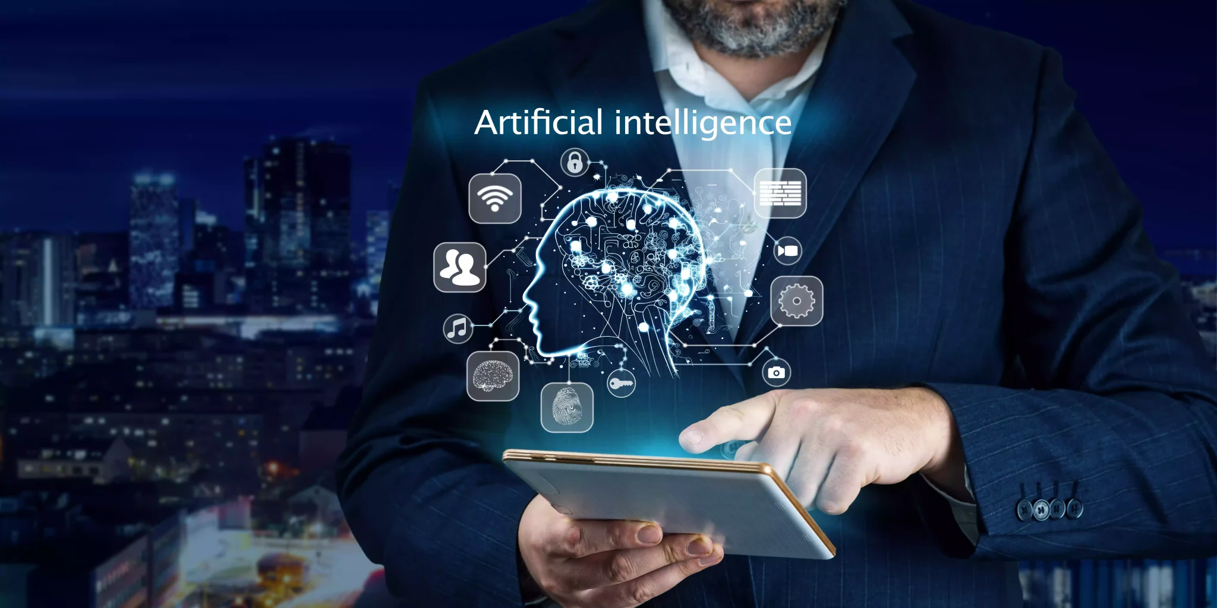
Non-functional Requirements
Performance
Scalability
Security
Usability
Reliability
IT21267086 | Hasara L. A. N | 24-25j-137

Slide 86
Software Requirements Specification
Development Environment
Programming Languages: Python, JavaScript (for web interface).
Frameworks: TensorFlow, Keras for deep learning; Flask or Django for backend
2. Database
NoSQL (e.g., MongoDB) for flexible data storage.
Relational Database (e.g., PostgreSQL) for structured data.
3. Tools
NLP Libraries: SpaCy, NLTK, Transformers.
Data Visualization: Matplotlib
4. Testing & Deployment
Unit and Integration Testing: PyTest, Selenium.
Continuous Integration/Continuous Deployment (CI/CD): Jenkins, Docker for containerization.
IT21267086 | Hasara L. A. N | 24-25j-137

Slide 87
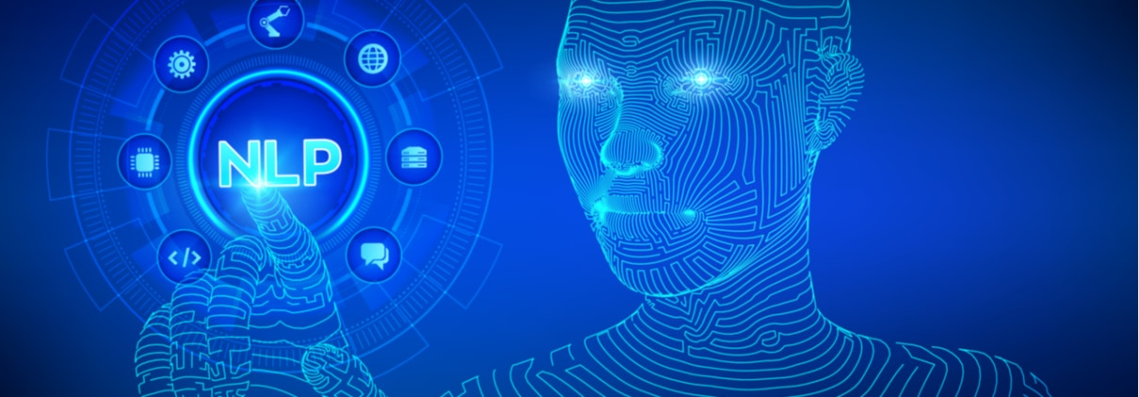
Technologies to be used
Natural Language Processing (NLP)
CNN
Bi-LSTM
Signal Media Dataset
SocialNet-Weibo Dataset
Data Preprocessing Techniques
Deep Learning Frameworks
IT21267086 | Hasara L. A. N | 24-25j-137

Slide 88
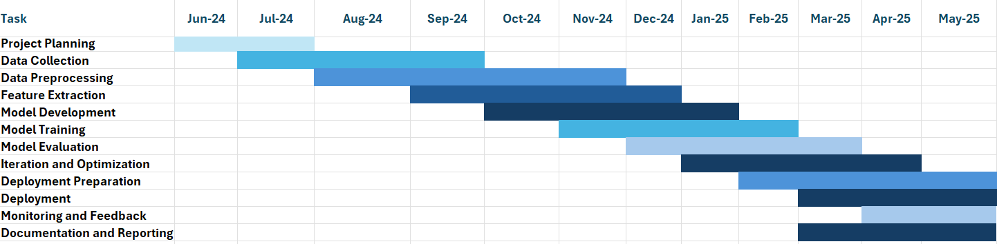
Gannt chart
IT21267086 | Hasara L. A. N | 24-25j-137

Slide 89
Commercialization
Market Opportunity:
Vast and rapidly expanding, driven by the urgent global need for reliable information, regulatory demands, and the increasing prevalence of misinformation across digital media platforms.
Target Audience:
News Consumers
General Public
Social Media Users
News Organizations
Journalists
Editors
Government and Public Policy Makers:
Regulatory Bodies
Policy Makers
IT21267086 | Hasara L. A. N | 24-25j-137

Slide 90
Budget
Description | Cost (LKR)
Data gathering | 20000
Internet Cost | 5000
Documentation | 6000
System designing | 50000
Implementation and Testing | 10000
Total | 83000
IT21267086 | Hasara L. A. N | 24-25j-137

Slide 91
REFERENCES
[1]. Mohawesh, R., Maqsood, S. & Althebyan, Q. Multilingual deep learning framework for fake news detection using capsule neural network. J Intell Inf Syst 60, 655–671 (2023). https://doi.org/10.1007/s10844-023-00788-y
[2]. Yadav, A.K., Kumar, S., Kumar, D. et al. Fake News Detection Using Hybrid Deep Learning Method. SN COMPUT. SCI. 4, 845 (2023). https://doi.org/10.1007/s42979-023-02296-w
[3]. Choudhary, Anshika & Arora, Anuja. (2020). Linguistic Feature Based Learning Model for Fake News Detection and Classification. Expert Systems with Applications. 169. 114171. 10.1016/j.eswa.2020.114171.
[4]. M. S. Mahesh, T. V and D. K, "Fake news detection in multiple platforms and languages ," 2024 International Conference on Advances in Data Engineering and Intelligent Computing Systems (ADICS), Chennai, India, 2024, pp. 1-6, doi: 10.1109/ADICS58448.2024.10533573. keywords: {Logistic regression;Machine learning algorithms;Machine learning;Information age;Data engineering;Complexity theory;Fake news;Fake News Detection;Multilingual Translation;Auto Language Detection;TF-IDF;Count Vectorization;Indian Fake News Dataset},
[5]. R. Arora, R. Gupta and P. Yadav, "Hybrid approach for detection of malicious profiles in Twitter ," 2024 4th International Conference on Innovative Practices in Technology and Management (ICIPTM), Noida, India, 2024, pp. 1-6, doi: 10.1109/ICIPTM59628.2024.10563278. keywords: {Uniform resource locators;Measurement;Accuracy;Social networking (online);Blogs;Forestry;Predictive models;URL;Random Forest;Blacklist;Machine Learning;and malicious URL Detection},
IT21267086 | Hasara L. A. N | 24-25j-137

Slide 92
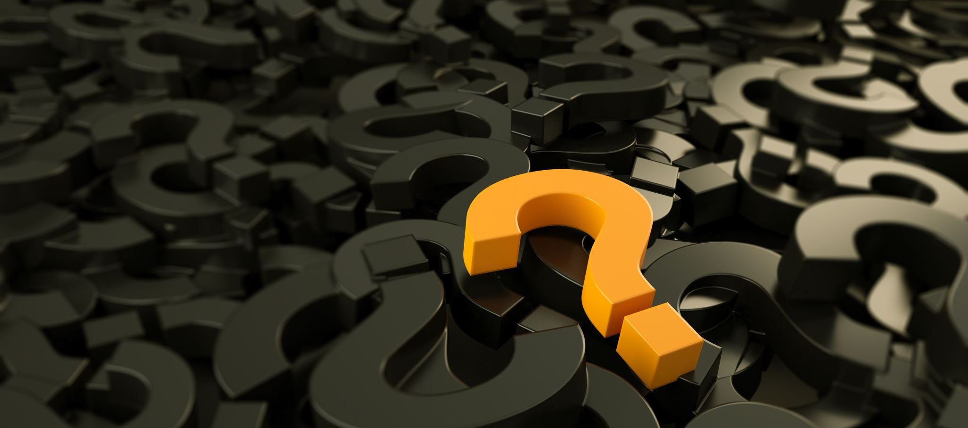
Q & A

